Slide 1

CSE 3521: Introduction to Artificial Intelligence
[Many slides are adapted from the UC Berkeley. CS188 Intro to AI at UC Berkeley and previous CSE 3521 course at OSU.]

Slide 2
Clustering

Slide 3
Today
An overview of unsupervised learning
Clustering
Generative models
K-means clustering
Agglomerative clustering
Gaussian mixture models (GMM): probabilistic clustering & generative models

Slide 4


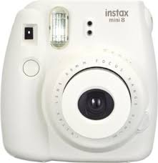
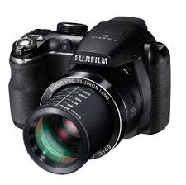
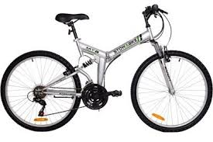
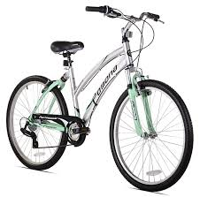
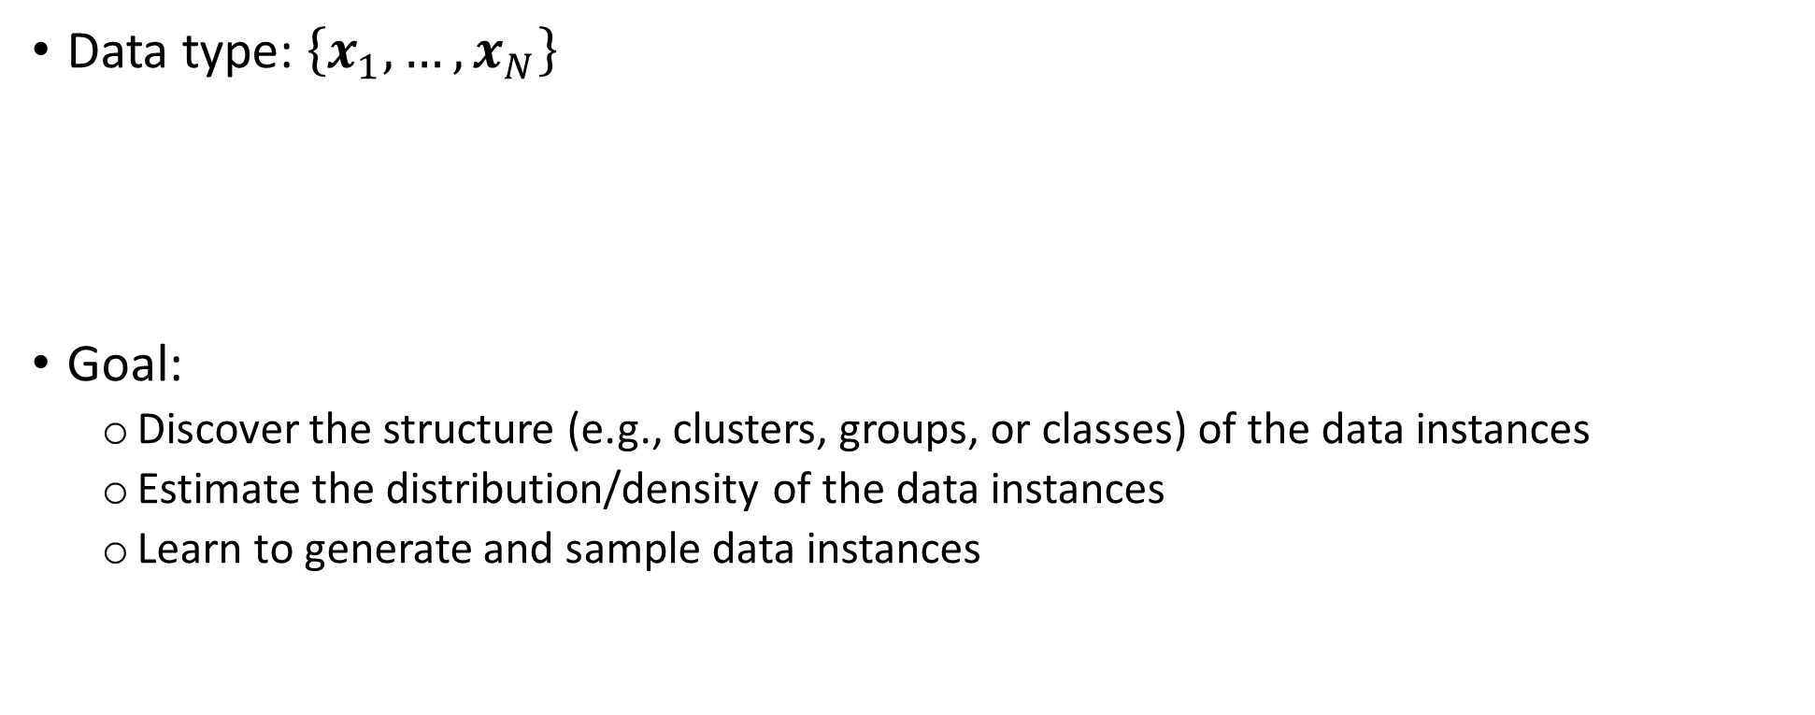
Unsupervised learning
Data type:$\left\{x_{1},…,x_{N}\right\}$
Goal:
Discover the structure (e.g., clusters, groups, or classes) of the data instances
Estimate the distribution/density of the data instances
Learn to generate and sample data instances

Slide 5
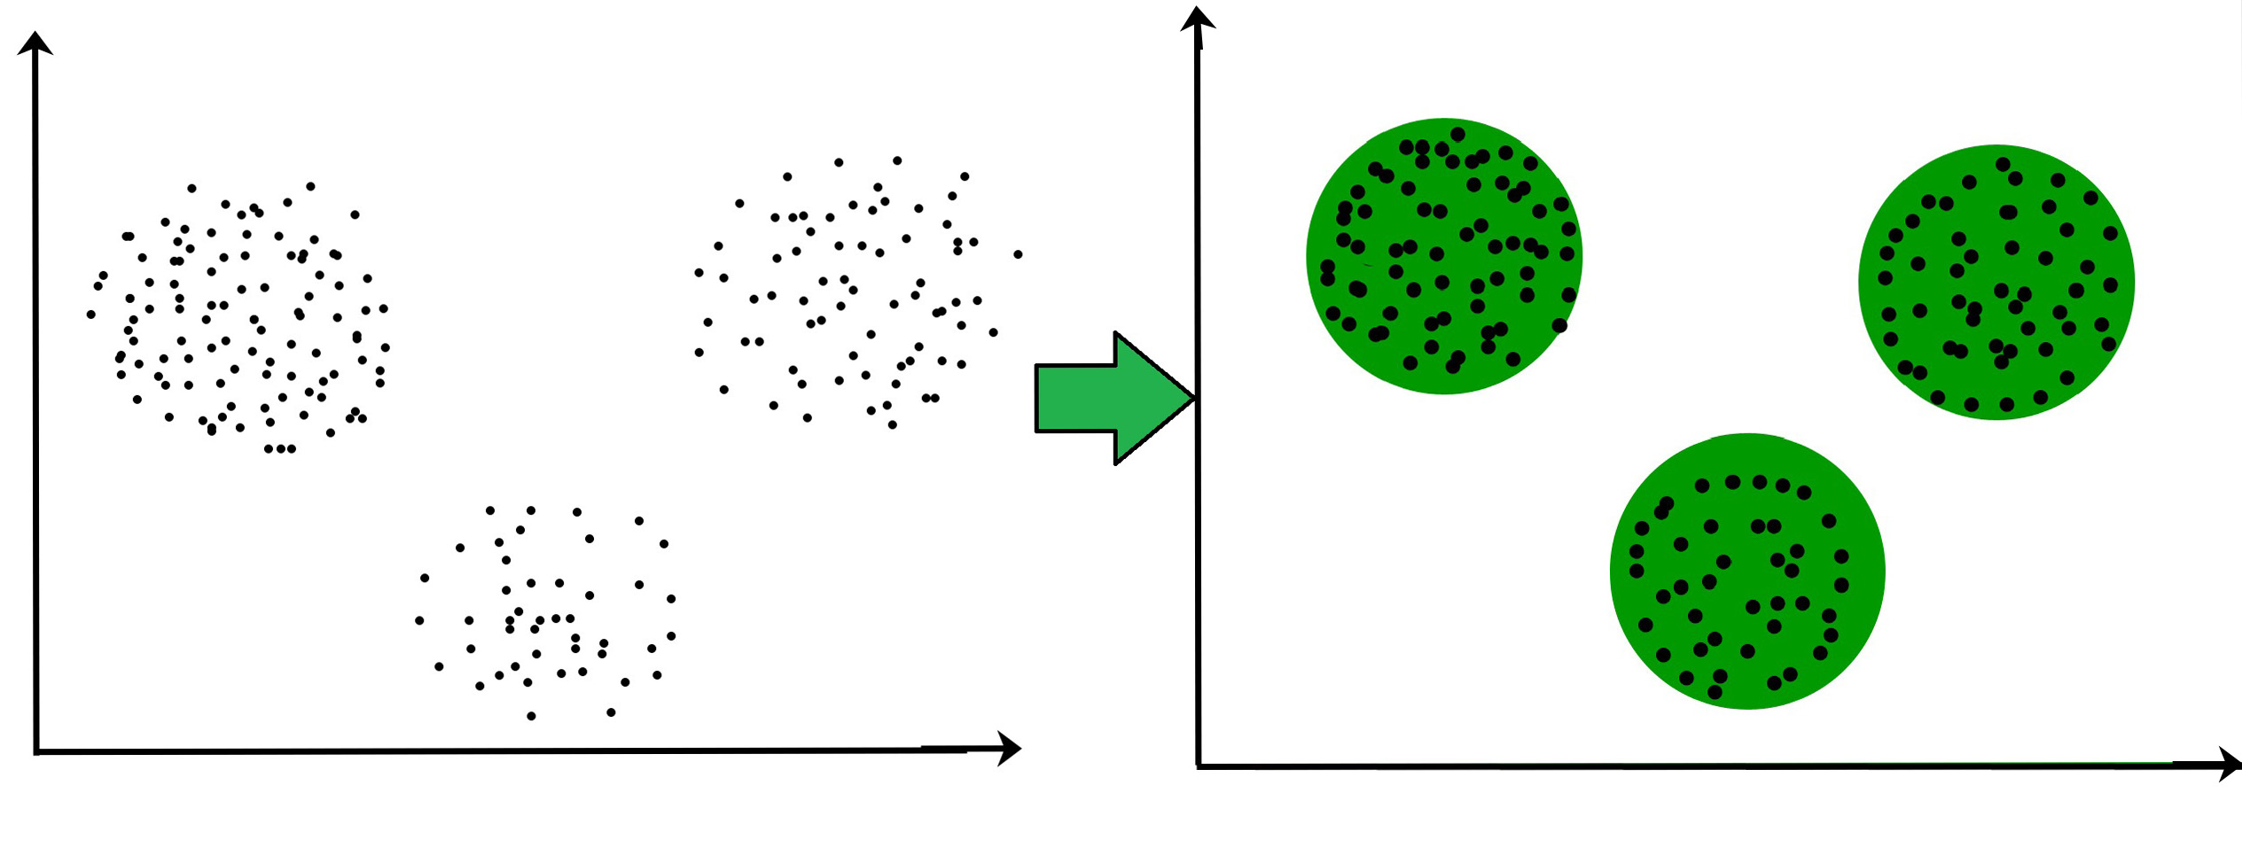
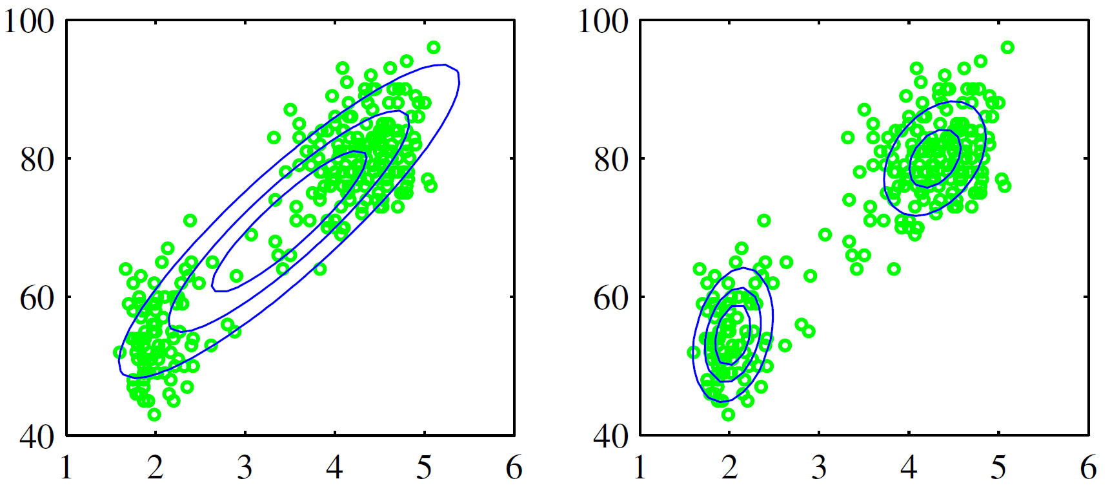
Unsupervised learning
Clustering:
Distribution/Density estimation
Can sample from the distribution to generate new data

Slide 6
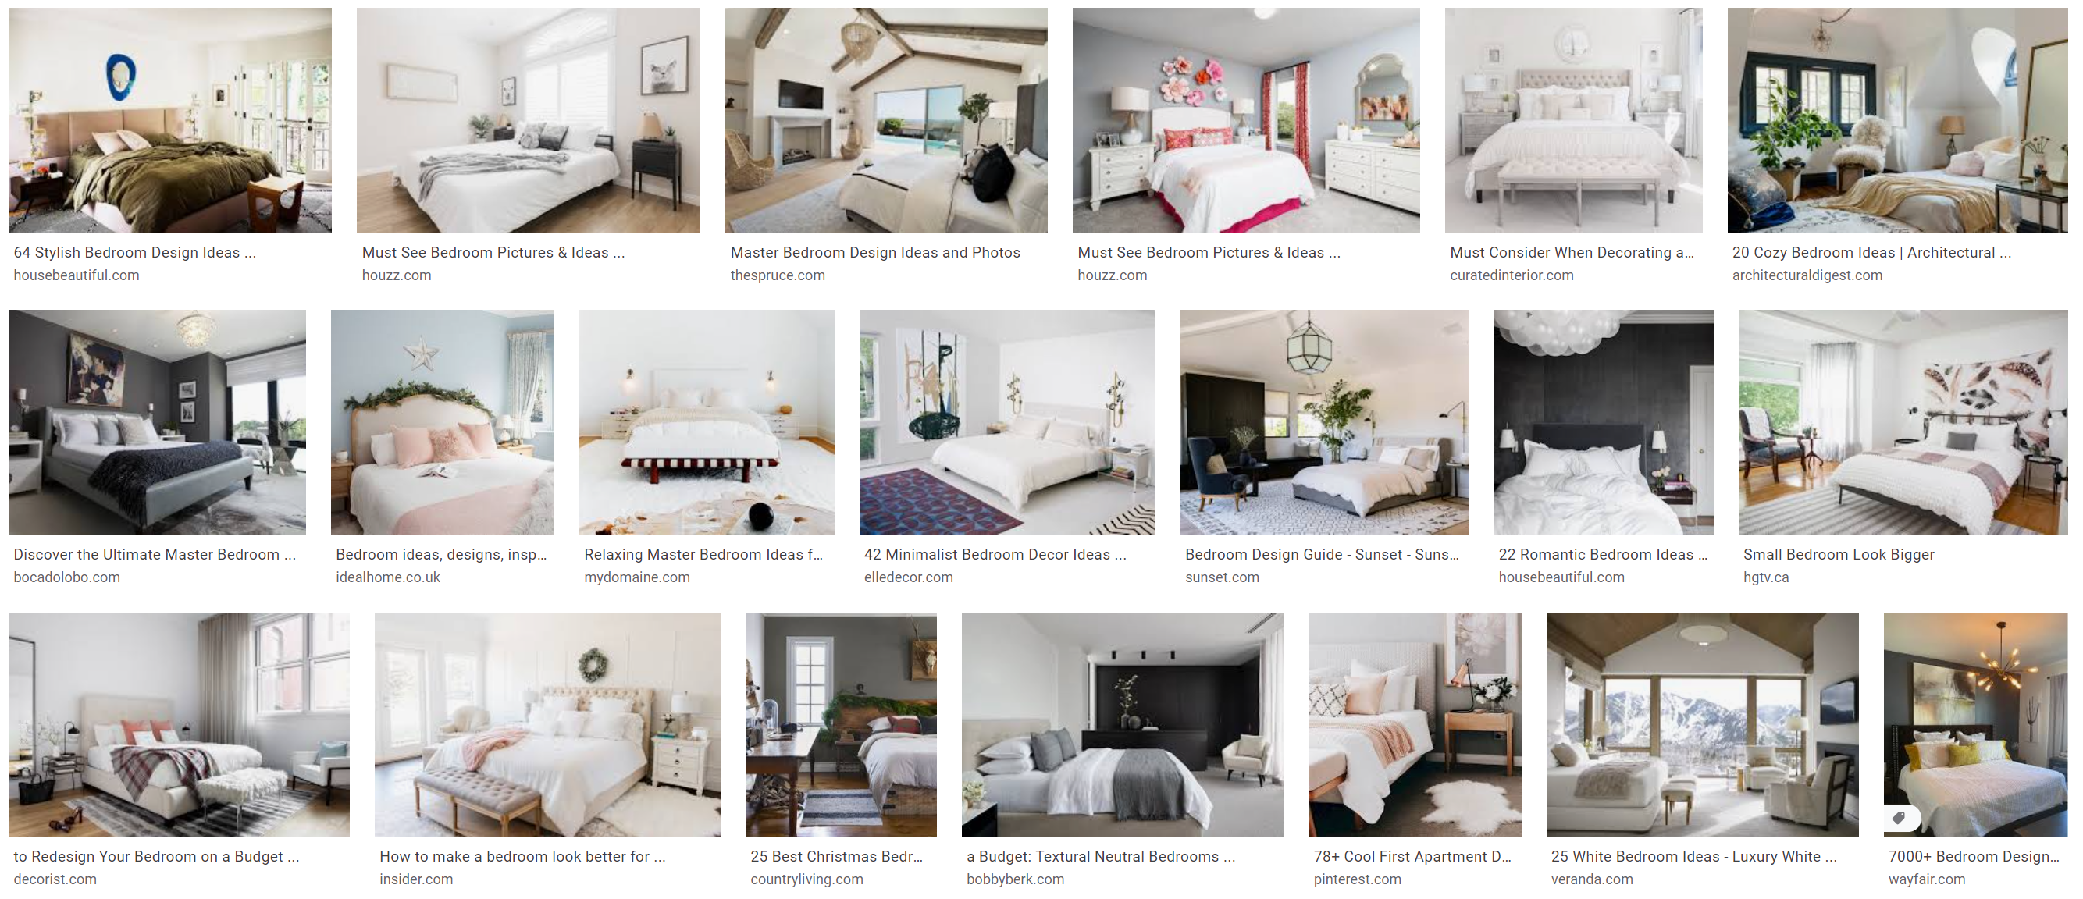
Unsupervised learning
Generative models
After seeing many data, can the model generate one?
Example: Google bedroom image search (real images)

Slide 7
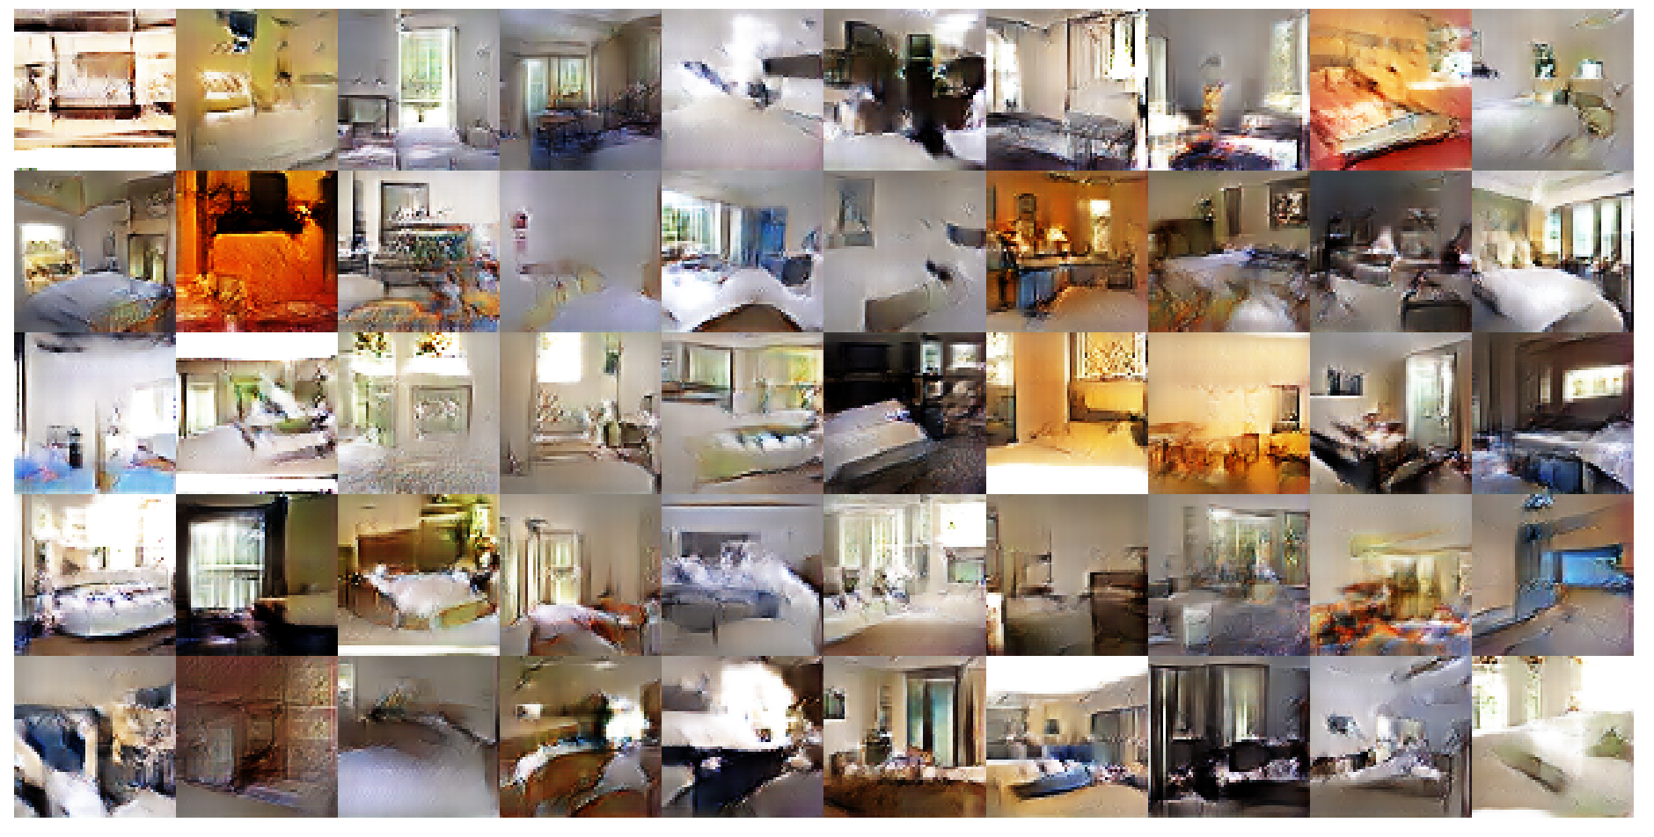
Unsupervised learning
Generative models
After seeing many data, can the model generate one?
Example: Machine generated images [Radford et al., ICLR 2016]

Slide 8
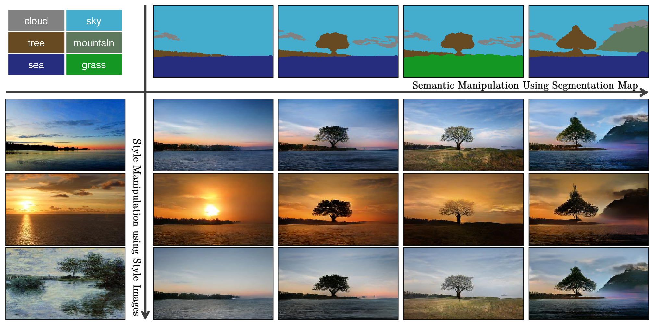
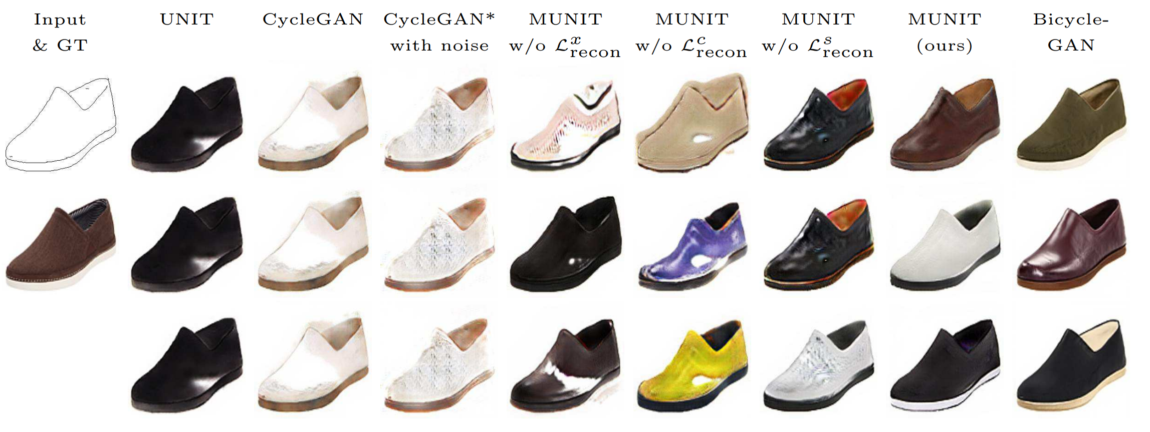
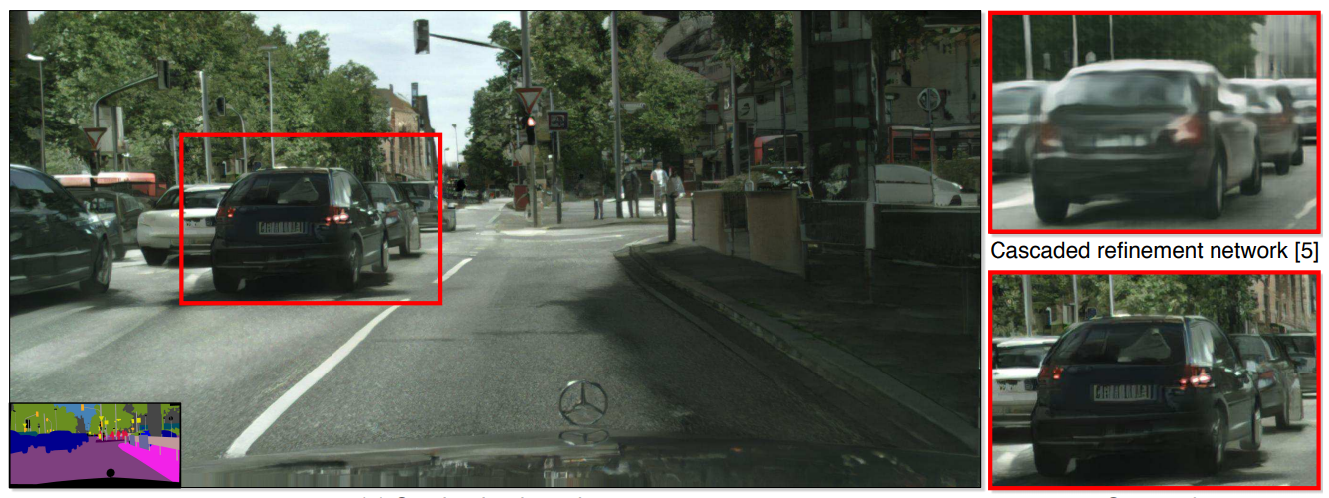
Unsupervised learning
Generative models (variants)
Image “translation”
[Huang et al., ECCV 2018]
Conditional image generation
[Wang et al., CVPR 2018]
[Park et al., CVPR 2019]

Slide 9
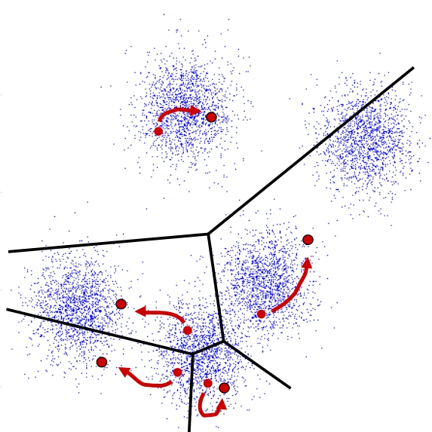
Clustering

Slide 10
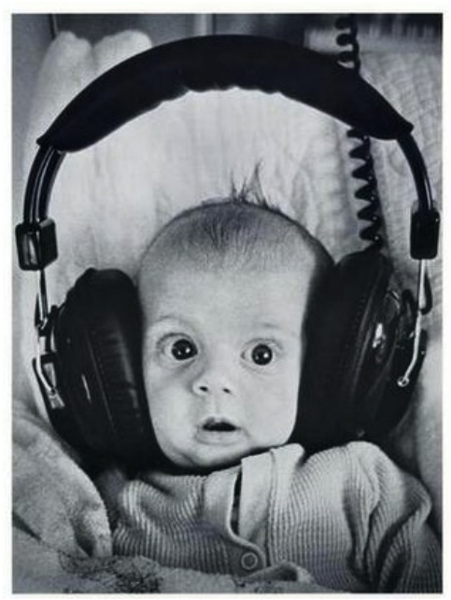

Clustering
Clustering systems:
Unsupervised learning
Detect patterns in unlabeled data
E.g. group emails or search results
E.g. find categories of customers
E.g. detect anomalous program executions
Useful when we don’t know what you are looking for
Requires data, but no labels
May get gibberish

Slide 11
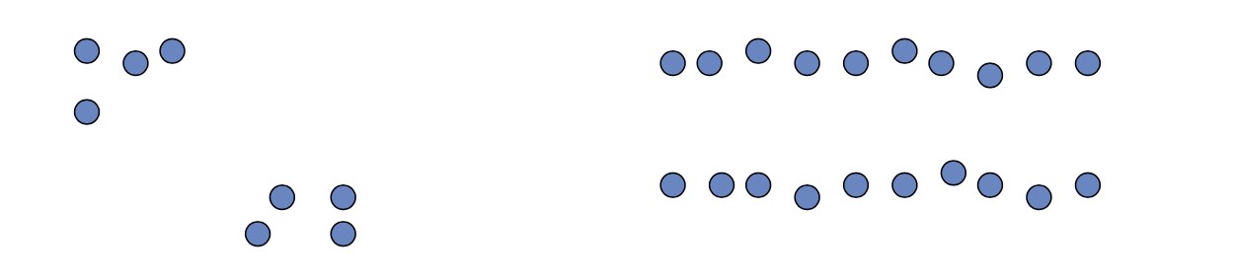
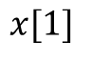
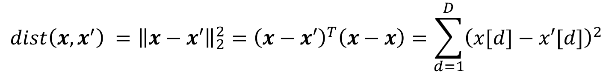
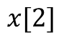
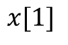
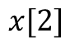
Clustering
Basic idea: group together similar instances
Example: 2D point patterns
What does “similar” mean?
One option: small (squared) Euclidean distance (i.e., L₂ distance)
$$x[2]$$
$$x[2]$$
$$x[1]$$
$$x[1]$$
$$dist\left(x,x^{′}\right) ={\left\|x−x′\right\|}_{2}^{2}={\left(x−x′\right)}^{T}\left(x−x\right)=\sum_{d=1}^{D}{{\left(x[d]−x′[d]\right)}^{2}}$$

Slide 12
Clustering
Basic idea: group together similar instances
Example: 2D point patterns
What does “similar” mean?
One option: small (squared) Euclidean distance (i.e., L₂ distance)
$$x[2]$$
$$x[2]$$
Need other distance metrics
Feature normalization
Other algorithms
$$x[1]$$
$$x[1]$$
$$dist\left(x,x^{′}\right) ={\left\|x−x′\right\|}_{2}^{2}={\left(x−x′\right)}^{T}\left(x−x\right)=\sum_{d=1}^{D}{{\left(x[d]−x′[d]\right)}^{2}}$$

Slide 13
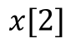
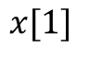
K-Means
Find K centers and group data instances into the K centers
Example: K = 2
Assign each data instance to the closet (most similar, smallest distant) center
$$x[2]$$
$$x[1]$$

Slide 14
K-Means
Find K centers and group data instances into the K centers
Example: K = 2
Assign each data instance to the closet (most similar, smallest distant) center
$$x[2]$$
$$x[1]$$

Slide 15
K-Means
Find K centers and group data instances into the K centers
Example: K = 2
Assign each data instance to the closet (most similar, smallest distant) center
$$x[2]$$
$$x[1]$$

Slide 16
K-Means
Find K centers and group data instances into the K centers
Example: K = 2
Assign each data instance to the closet (most similar, smallest distant) center
$$x[2]$$
$$x[1]$$

Slide 17
K-Means
Find K centers and group data instances into the K centers simultaneously
Chicken-egg problem: need to have centers before assignments, but where are the centers?
$$x[2]$$
$$x[1]$$

Slide 18
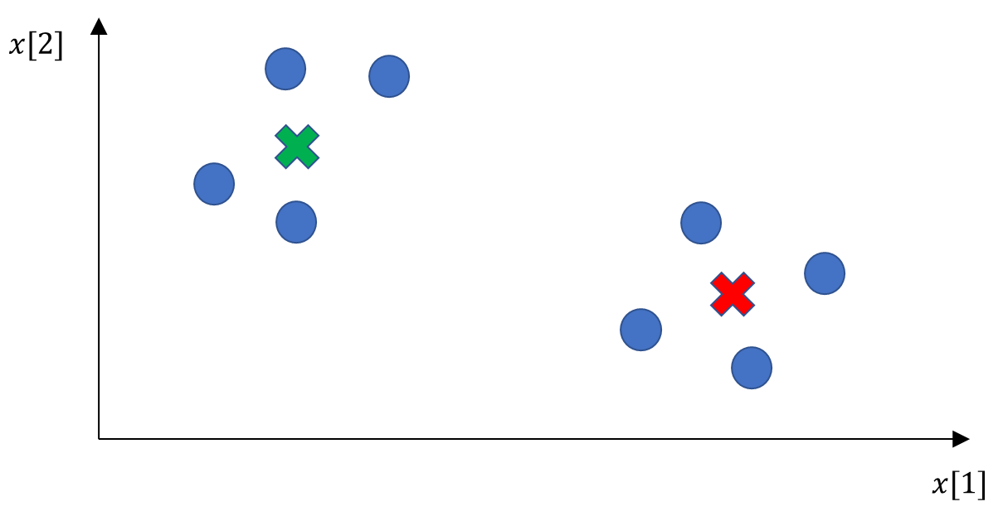
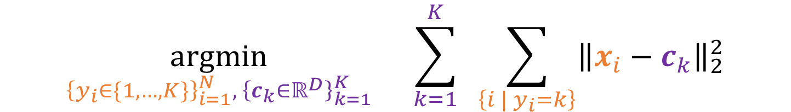
K-Means
Formulate as an optimization problem (total distance to the centers)
To find centers (K of them) and group assignments (N data instances) simultaneously
$$\underset{{{\left\{y_{i}∈\{1,…,K\}\right\}}_{i=1}^{N}, \left\{c_{k}∈ℝ^{D}\right\}}_{k=1}^{K}}{argmin}{ \sum_{k=1}^{K}{ \sum_{\left\{i | y_{i}=k\right\}}{{\left\|x_{i}−c_{k}\right\|}_{2}^{2}}}}$$
All data instances assigned to group k

Slide 19
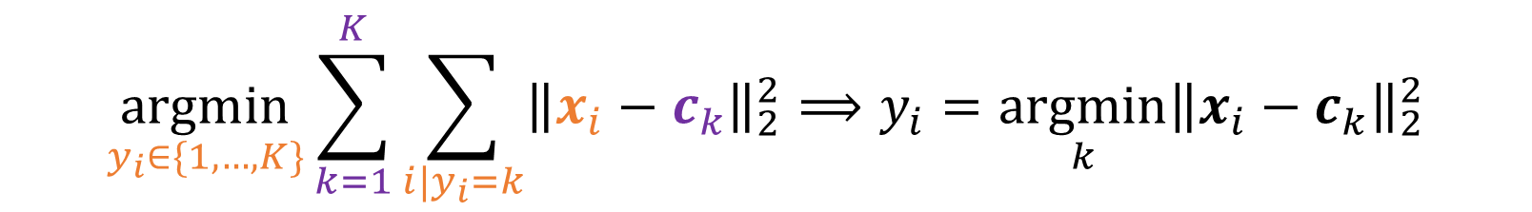
K-Means
Formulate as an optimization problem (total distance to the centers)
To find centers (K of them) and group assignments (N data instances) simultaneously
Given centers, then for each data point i, the assignment is independent
$$\underset{{{\left\{y_{i}∈\{1,…,K\}\right\}}_{i=1}^{N}, \left\{c_{k}∈ℝ^{D}\right\}}_{k=1}^{K}}{argmin}{ \sum_{k=1}^{K}{ \sum_{\left\{i | y_{i}=k\right\}}{{\left\|x_{i}−c_{k}\right\|}_{2}^{2}}}}$$
All data instances assigned to group k
$$\underset{y_{i}∈\{1,…,K\}}{argmin}{\sum_{k=1}^{K}{\sum_{i|y_{i}=k}{{\left\|x_{i}−c_{k}\right\|}_{2}^{2}}}}⟹y_{i}=\underset{k}{argmin}{{\left\|x_{i}−c_{k}\right\|}_{2}^{2}}$$

Slide 20
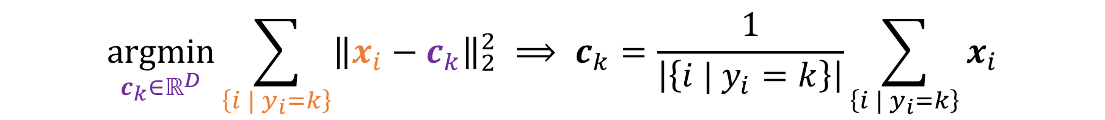
K-Means
Formulate as an optimization problem (total distance to the centers)
To find centers (K of them) and group assignments (N data instances) simultaneously
Given assignments, then finding the center for each group k is independent
$$\underset{{{\left\{y_{i}∈\{1,…,K\}\right\}}_{i=1}^{N}, \left\{c_{k}∈ℝ^{D}\right\}}_{k=1}^{K}}{argmin}{ \sum_{k=1}^{K}{ \sum_{\left\{i | y_{i}=k\right\}}{{\left\|x_{i}−c_{k}\right\|}_{2}^{2}}}}$$
All data instances assigned to group k
$$\underset{c_{k}∈ℝ^{D}}{argmin}{\sum_{\left\{i | y_{i}=k\right\}}{{\left\|x_{i}−c_{k}\right\|}_{2}^{2}}} ⟹ c_{k}=\frac{1}{\left|\left\{i | y_{i}=k\right\}\right|}\sum_{\left\{i | y_{i}=k\right\}}{x_{i}}$$

Slide 21


K-Means: an iterative clustering algorithm
Pick K random points as cluster centers (means): c₁…c_{K}
Alternate (the error is monotonically decreasing):
Assign each example x_{i} to the mean c_{k} that is closest to it
Set each mean c_{k} to the average of its assigned points
Stop when no points assignments change
$$\underset{y_{i}∈\{1,…,K\}}{argmin}{\sum_{k=1}^{K}{\sum_{i|y_{i}=k}{{\left\|x_{i}−c_{k}\right\|}_{2}^{2}}}}⟹y_{i}=\underset{k}{argmin}{{\left\|x_{i}−c_{k}\right\|}_{2}^{2}}$$
$$\underset{c_{k}∈ℝ^{D}}{argmin}{\sum_{\left\{i | y_{i}=k\right\}}{{\left\|x_{i}−c_{k}\right\|}_{2}^{2}}} ⟹ c_{k}=\frac{1}{\left|\left\{i | y_{i}=k\right\}\right|}\sum_{\left\{i | y_{i}=k\right\}}{x_{i}}$$

Slide 22
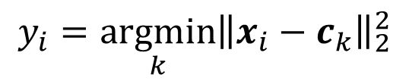
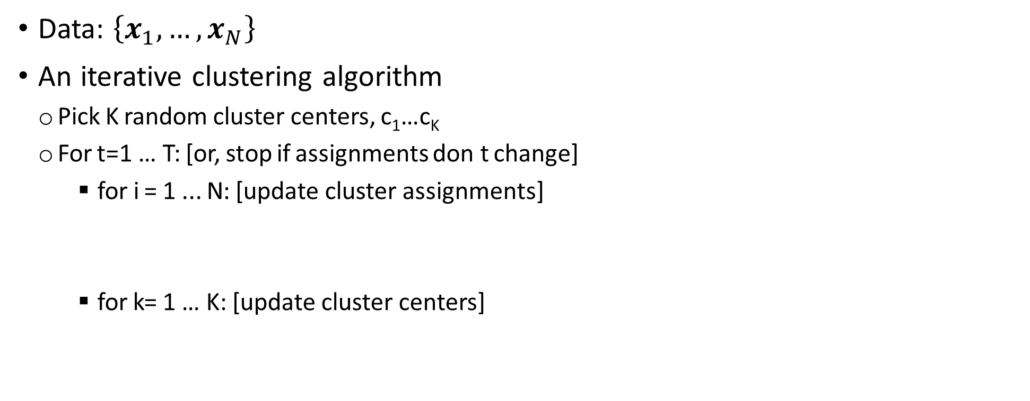
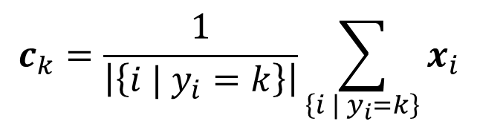
K-Means
Data: $\left\{x_{1},…,x_{N}\right\}$
An iterative clustering algorithm
Pick K random cluster centers, c₁…c_{K}
For t=1 … T: [or, stop if assignments don t change]
for i = 1 ... N: [update cluster assignments]
for k= 1 … K: [update cluster centers]
$$y_{i}=\underset{k}{argmin}{{\left\|x_{i}−c_{k}\right\|}_{2}^{2}}$$
$$c_{k}=\frac{1}{\left|\left\{i | y_{i}=k\right\}\right|}\sum_{\left\{i | y_{i}=k\right\}}{x_{i}}$$

Slide 23
K-Means
 | x[1] | x[2]
i=1 | -1 | 0
i=2 | 0 | 0
i=3 | 2 | 2
Random cluster means:
c₁=[-1,0], c₂=[0,0]
t = 0:
y₁ = argmin_{k} dist(x₁,c_{k}) = 1
y₂ = argmin_{k} dist(x₂,c_{k}) = 1
y₃ = argmin_{k} dist(x₃,c_{k}) = 2
c₁ = (1/1) * [-1,0] = [-1,0]
c₂ = ((1/2) * ([0,0]+[2,2]) = [1,1]
c₁=[-1,0], c₂=[1,1]
t = 1 :
y₁ = argmin_{k} dist(x₁,c_{k}) = 1
y₂ = argmin_{k} dist(x₂,c_{k}) = 1
y₃ = argmin_{k} dist(x₃,c_{k}) = 2
c₁ = (1/2) * ([-1,0]+[0,0]) = [-0.5,0]
c₂ = (1/1) * ([2,2]) = [2,1]
t=2:
Stop!!
y_{i} won’t change (verify!)
 | i=1 | i=2 | i=3
c₁ | 0 | 1 | 13
c₂ | 1 | 0 | 8
 | i=1 | i=2 | i=3
c₁ | 0 | 1 | 13
c₂ | 4 | 4 | 18
x[2]
x[1]

Slide 24
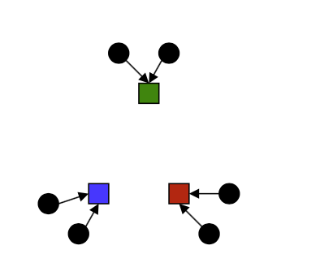
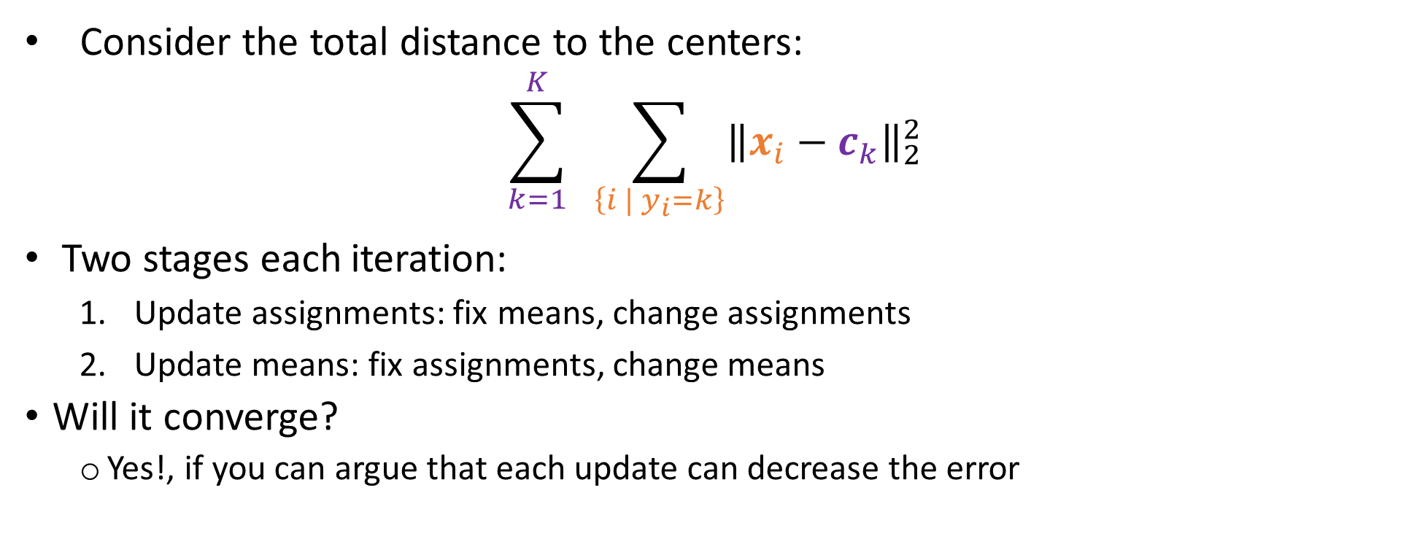
K-Means optimization: a second glance
Consider the total distance to the centers:
$$\sum_{k=1}^{K}{ \sum_{\left\{i | y_{i}=k\right\}}{{\left\|x_{i}−c_{k}\right\|}_{2}^{2}}}$$
Two stages each iteration:
Update assignments: fix means, change assignments
Update means: fix assignments, change means
Will it converge?
Yes!, if you can argue that each update can decrease the error

Slide 25
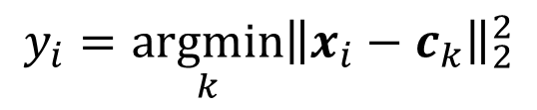
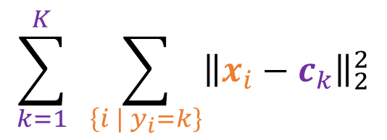
Phase I: Update Assignments
For each point, re-assign to closest mean:
Can only decrease the total distance
$$y_{i}=\underset{k}{argmin}{{\left\|x_{i}−c_{k}\right\|}_{2}^{2}}$$
$$\sum_{k=1}^{K}{ \sum_{\left\{i | y_{i}=k\right\}}{{\left\|x_{i}−c_{k}\right\|}_{2}^{2}}}$$

Slide 26
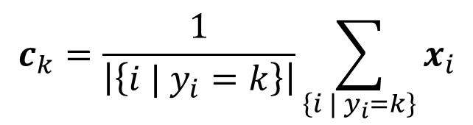
Phase II: Update Means
Move each mean to the average of its assigned points:
Also can only decrease total distance… (Why?)
The point c_{k} with the least squared Euclidean distance to points {x_{i} | y_{i} = k} is their mean
Proof: take partial derivative w.r.t. c_{k} and set it to 0 to find c_{k}
$$c_{k}=\frac{1}{\left|\left\{i | y_{i}=k\right\}\right|}\sum_{\left\{i | y_{i}=k\right\}}{x_{i}}$$
$$\sum_{k=1}^{K}{ \sum_{\left\{i | y_{i}=k\right\}}{{\left\|x_{i}−c_{k}\right\|}_{2}^{2}}}$$

Slide 27

K-means: animation

Slide 28
Initialization
K-means is non-deterministic
Requires initial means
It does matter what you pick!
What can go wrong?
Various schemes for preventing this kind of thing:
Variance-based split / merge, initialization heuristics

Slide 29
K-Means Getting Stuck
A local optimum:
Ideally, we want the purple center to take half of the blue points, but the initial centers locations lead to a sub-optimal solutions.

Slide 30
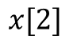
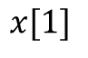
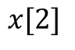
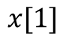
K-Means Questions
What distance to use?
Square Euclidean: mean
L1 distance: medium
Perform feature transform before K-means
Variants:
K-medoid: chooses data points as centers (medoids) and can be used with arbitrary distances
$$x[2]$$
$$x[2]$$
$$x[1]$$
$$x[1]$$

Slide 31
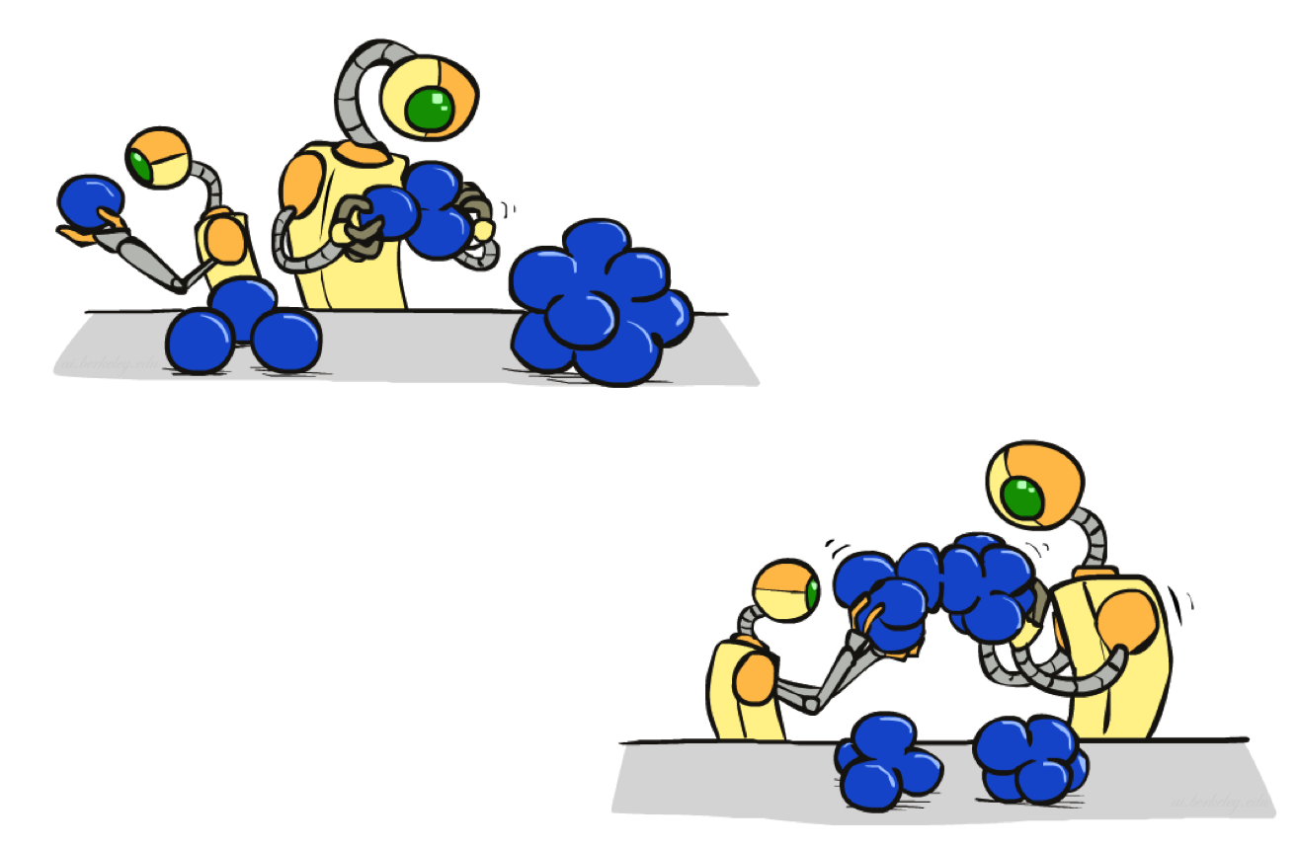
Agglomerative Clustering

Slide 32
Agglomerative Clustering
Agglomerative clustering:
First merge very similar instances
Incrementally build larger clusters out of smaller clusters
Algorithm:
Maintain a set of clusters
Initially, each instance in its own cluster
Repeat:
Pick the two closest clusters
Merge them into a new cluster
Stop when there is only one cluster left
Produces not one clustering, but a family of clusters represented by a dendrogram

Slide 33
Agglomerative Clustering
How should we define “closest” for clusters with multiple elements?
Many options
Closest pair (single-link clustering)
Farthest pair (complete-link clustering)
Average of all pairs
Ward’s method (min variance, like k-means)
Different choices create different clustering behaviors

Slide 34
Agglomerative Clustering
complete link
single link
2 1.8 1.6 1.4 1.2
1 0.8 0.6 0.4 0.2
0.3
0.25
0.2
0.15
0.1
0.05
Each discrete value alone the x-axis is treated as one data instance.

Slide 35
Agglomerative Clustering
complete link
single link
2 1.8 1.6 1.4 1.2
1 0.8 0.6 0.4 0.2
0.3
0.25
0.2
0.15
0.1
0.05
Each discrete value alone the x-axis is treated as one data instance.

Slide 36
Agglomerative Clustering
complete link
single link
2 1.8 1.6 1.4 1.2
1 0.8 0.6 0.4 0.2
0.3
0.25
0.2
0.15
0.1
0.05
Each discrete value alone the x-axis is treated as one data instance.

Slide 37
Agglomerative Clustering
complete link
single link
2 1.8 1.6 1.4 1.2
1 0.8 0.6 0.4 0.2
0.3
0.25
0.2
0.15
0.1
0.05
Each discrete value alone the x-axis is treated as one data instance.

Slide 38
Agglomerative Clustering
complete link
single link
2 1.8 1.6 1.4 1.2
1 0.8 0.6 0.4 0.2
0.3
0.25
0.2
0.15
0.1
0.05
Each discrete value alone the x-axis is treated as one data instance.

Slide 39
Agglomerative Clustering
complete link
single link
2 1.8 1.6 1.4 1.2
1 0.8 0.6 0.4 0.2
0.3
0.25
0.2
0.15
0.1
0.05
Each discrete value alone the x-axis is treated as one data instance.

Slide 40
Agglomerative Clustering
complete link
single link
2 1.8 1.6 1.4 1.2
1 0.8 0.6 0.4 0.2
0.3
0.25
0.2
0.15
0.1
0.05
Each discrete value alone the x-axis is treated as one data instance.

Slide 41
Agglomerative Clustering
complete link
single link
2 1.8 1.6 1.4 1.2
1 0.8 0.6 0.4 0.2
0.3
0.25
0.2
0.15
0.1
0.05
Each discrete value alone the x-axis is treated as one data instance.

Slide 42
Agglomerative Clustering
complete link
single link
2 1.8 1.6 1.4 1.2
1 0.8 0.6 0.4 0.2
0.3
0.25
0.2
0.15
0.1
0.05
Each discrete value alone the x-axis is treated as one data instance.

Slide 43
Agglomerative Clustering
complete link
single link
2 1.8 1.6 1.4 1.2
1 0.8 0.6 0.4 0.2
0.3
0.25
0.2
0.15
0.1
0.05
Each discrete value alone the x-axis is treated as one data instance.

Slide 44
Agglomerative Clustering
complete link
single link
2 1.8 1.6 1.4 1.2
1 0.8 0.6 0.4 0.2
0.3
0.25
0.2
0.15
0.1
0.05
Each discrete value alone the x-axis is treated as one data instance.

Slide 45
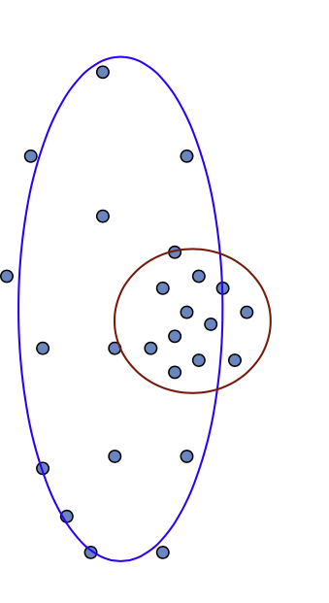
(One) bad case for “hard assignments”?
Clusters may overlap
Some clusters may be “wider” than others

Slide 46
(One) bad case for “hard assignments”?
Clusters may overlap
Some clusters may be “wider” than others
Distances can be deceiving!

Slide 47
Probabilistic clustering / Generative models

Slide 48
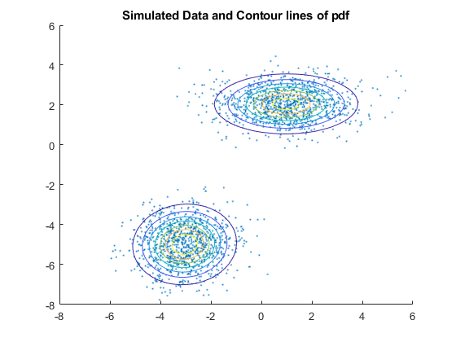
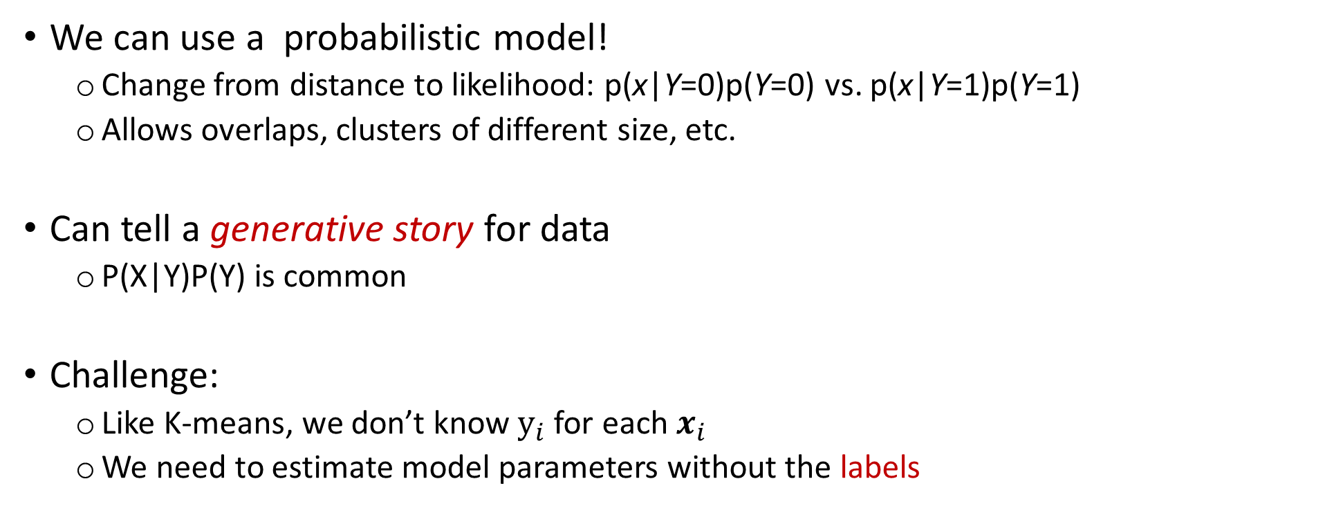
Probabilistic Clustering
We can use a probabilistic model!
Change from distance to likelihood: p(x|Y=0)p(Y=0) vs. p(x|Y=1)p(Y=1)
Allows overlaps, clusters of different size, etc.
Can tell a generative story for data
P(X|Y)P(Y) is common
Challenge:
Like K-means, we don’t know $y_{i}$ for each$x_{i}$
We need to estimate model parameters without the labels

Slide 49
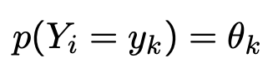
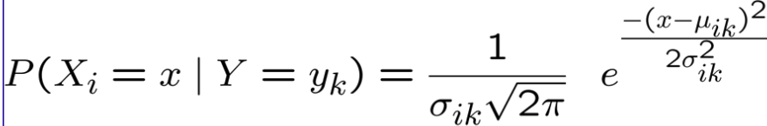
What model to use
Depends on X!
Gaussian Naïve Bayes
Multinomial over cluster Y,
Gaussian over each X_{i} given Y

Slide 50
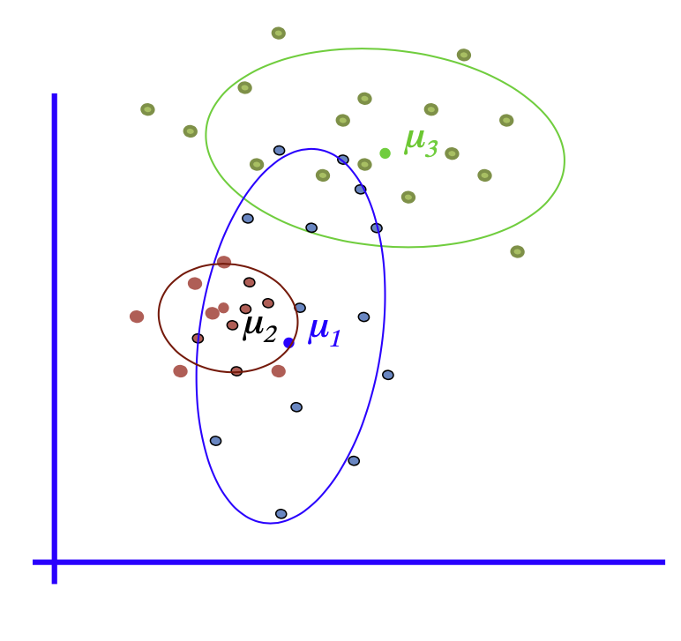
General GMM assumption
P(Y): There are K components (classes)
P(X|Y): Each component generates data from a Gaussian with mean μ_{i} and covariance matrix Σ_{i}
Each data point is sampled from a generative process:
Pick a component at random: Choose component i with probability P(y=i)
Datapoint ~N(μ_{i}, Σ_{i} )

Slide 51
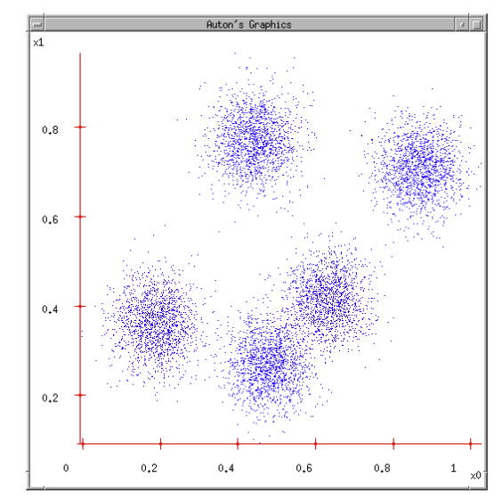
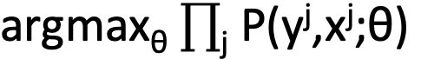
How to estimate parameter
MLE:
θ: all model parameters
e.g., class probability, means, and variance for naïve Bayes
But we don t know y_{j}!!!
Maximize marginal likelihood:

Slide 52
How do we optimize? Closed Form?
Maximize marginal likelihood:
Almost always a hard problem!
Usually no closed form solution
Even when P(X, Y ; θ) is convex, P(X;θ) generally is not
For all but the simplest P(X;θ),
we will have to do gradient ascent, in a big messy space with lots of local optimum…

